Slide 1
Xia and Galvin Quiz
11/21/19

Slide 2
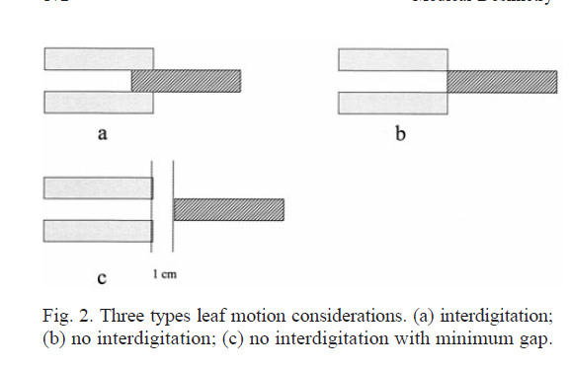
Q1
Explain the three types of leaf motion and which vendor has each.
A) varian
B) siemens
C) elek
Explain single vs double focused; which vendor uses which design?
What TG report could you reference for more information?

Slide 3
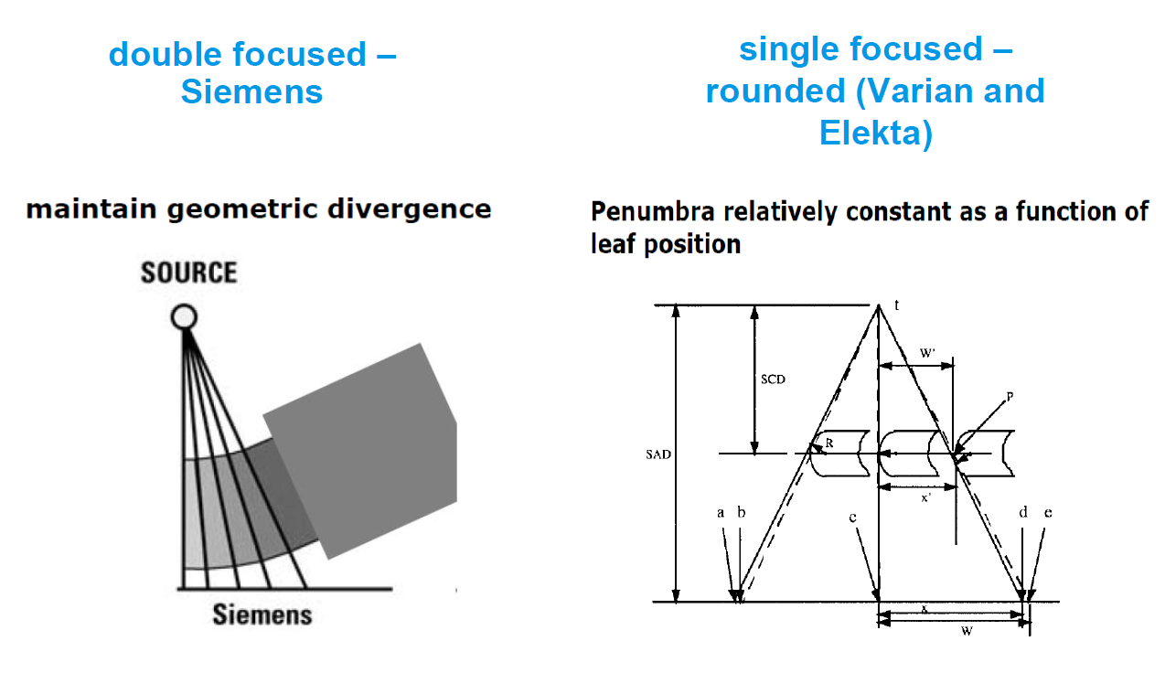
Q1 - answer

Slide 4
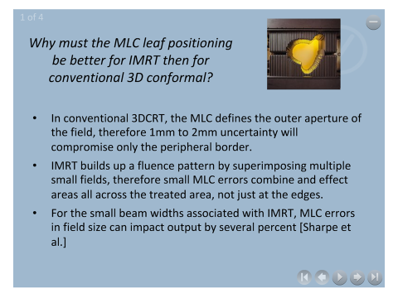
Q2

Slide 5
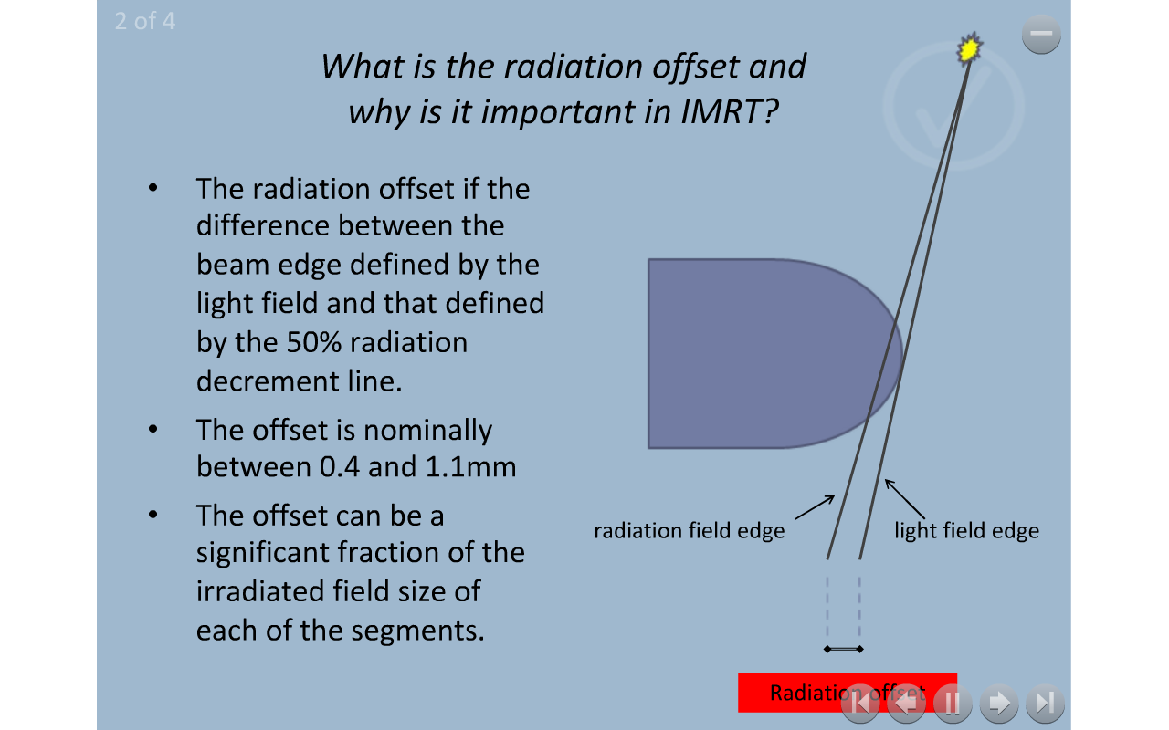
Q2

Slide 6
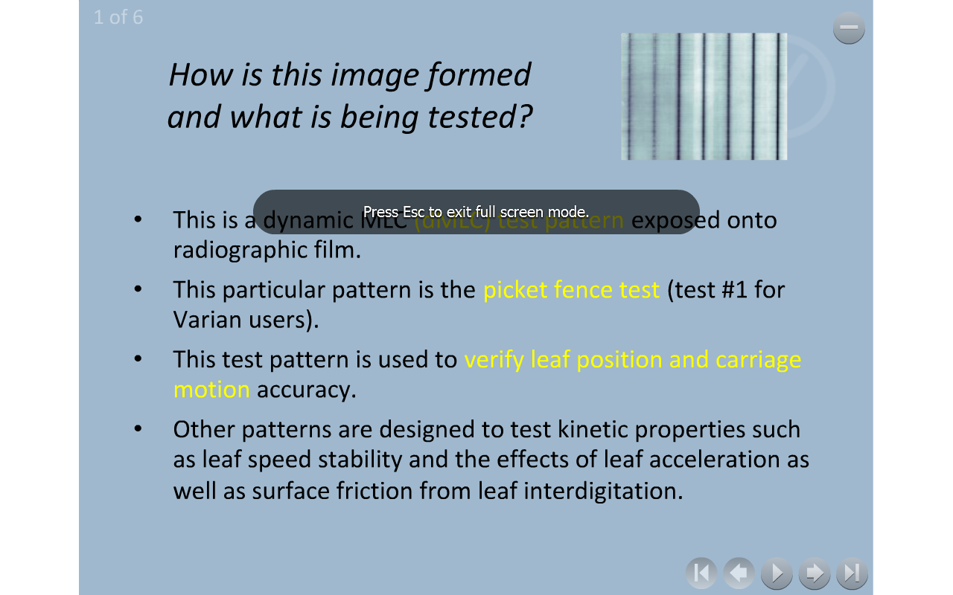
Q2

Slide 7
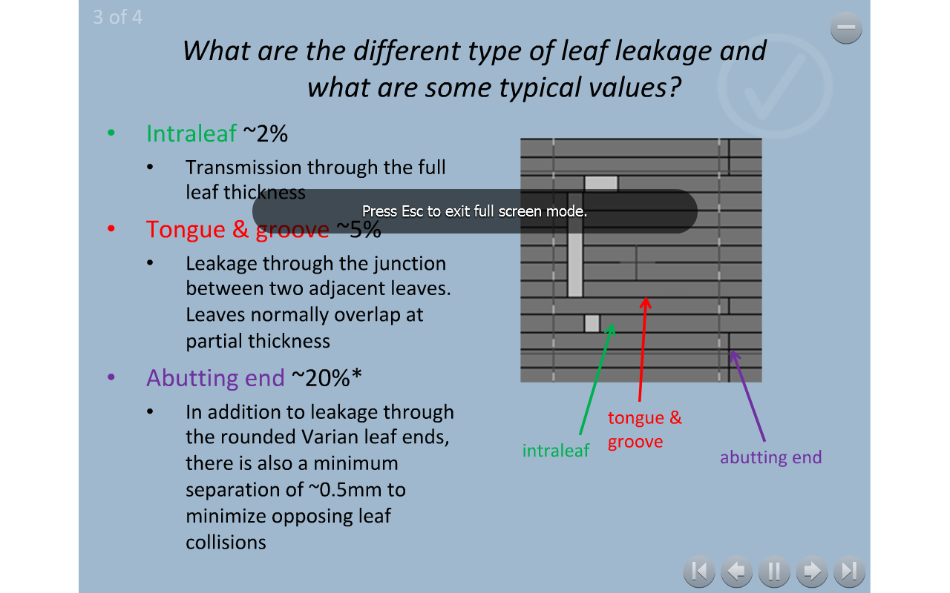
Q2

Slide 8
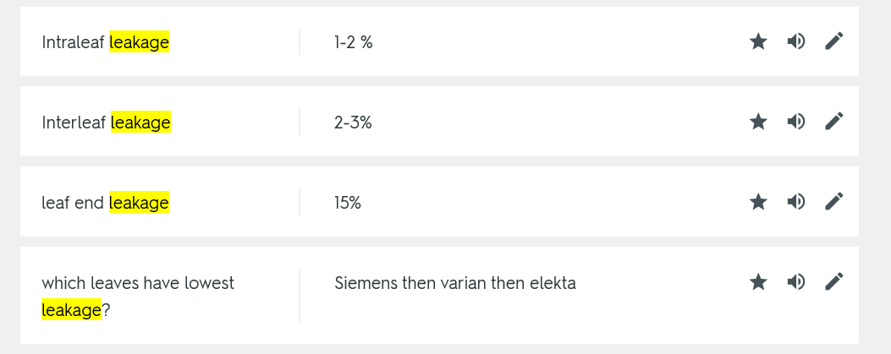
Q2 - answer

Slide 9
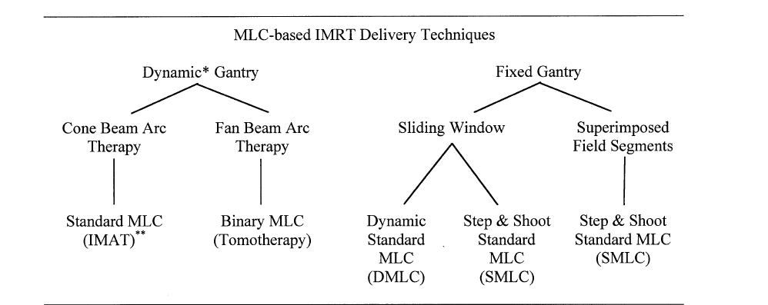
Q3
Fill in the boxes and explain the difference between the methods.
Which method(s) do you use in your clinic?
How does this effect what optimization is used?

Slide 10
Q4
Your clinic is only treating with 3D conformal technique now. You are planning to start IMRT program in your clinic. Explain what the physicist needs to consider when implementing the program in your clinic?

Slide 11
Q5
Explain the problem of “dose dumping”
What strategies can be implemented to reduce this problem?

